Slide 1
Predictive Modeling of Covid-19 with Chest X-rays
By Keefer Chern, Zixuan Yao, Ziyi Wang, Mou Zhang

Slide 2
Background
Covid-19 is an extremely distressing ongoing pandemic that has negatively impacted the lives of all people globally.
One significant issue surrounding the virus is difficulty in getting a diagnosis for the virus, especially in poorer countries without any medical resources.
We wish to create an algorithm that will quickly determine whether an individual has been infected by the Covid-19 virus with only an chest X-ray.

Slide 3
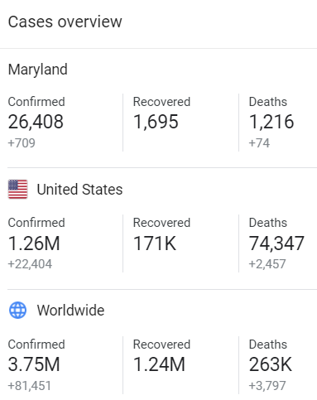
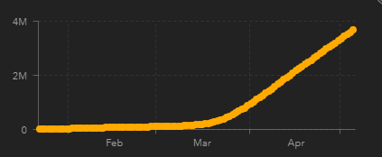
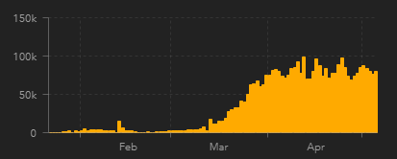
Coronavirus Statistics
Confirmed Cases
Daily Cases
Source: Google
Source: Johns Hopkins

Slide 4
Approach
Step 1 (2 Classes)
Step 2 (>2 Classes)
Data Visualization
Determining data points for consistency
Self-constructed CNN
3-layers
Dropout
Pooling
ResNet
Transfer learning
VGG
ResNet
Data Visualization
Determining data points for consistency
Self-constructed CNN
3-layers
Dropout
Pooling
ResNet
Transfer learning
VGG
ResNet

Slide 5
Methods(Data)
We performed data visualization on the data to determine important features and what data to utilize.
Step 1: We worked specifically with a dataset of randomly picked 200 images, with 100 being healthy patients and the 100 being patients with Covid-19.
Step 2: We worked specifically with a dataset of randomly picked 225 images, with 75 being healthy patients and the 75 being patients with Covid-19, and 75 with other pneumonia.
Step 2.5: We worked specifically with a dataset of randomly picked 300 images, with 75 being healthy patients and the 75 being patients with Covid-19, 75 with other bacteria, 75 over viral.

Slide 6
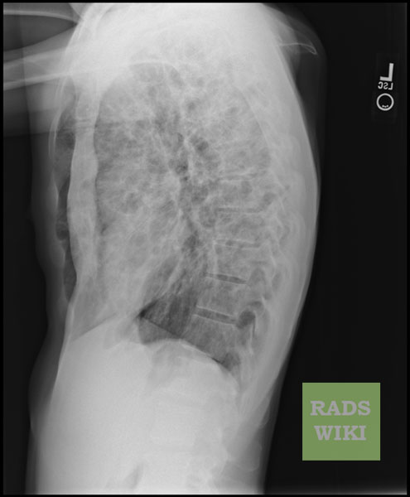
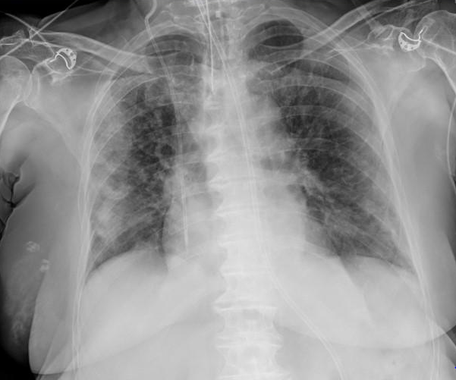
Methods (Filtered Data)
Not Consistent
Used for consistency.
Source: https://github.com/ieee8023/covid-chestxray-dataset/blob/master/README.md
Notes:
Filtered

Slide 7
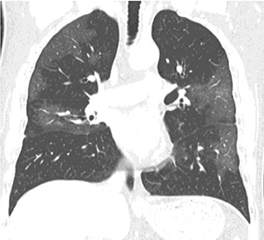
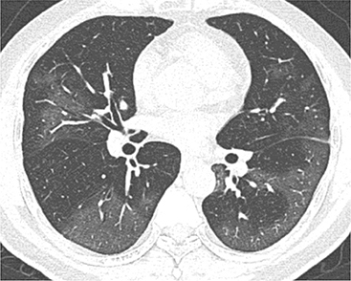
Methods (Filtered Data)
Not Consistent
Used for consistency.
Source: https://github.com/ieee8023/covid-chestxray-dataset/blob/master/README.md
Notes:
Filtered

Slide 8
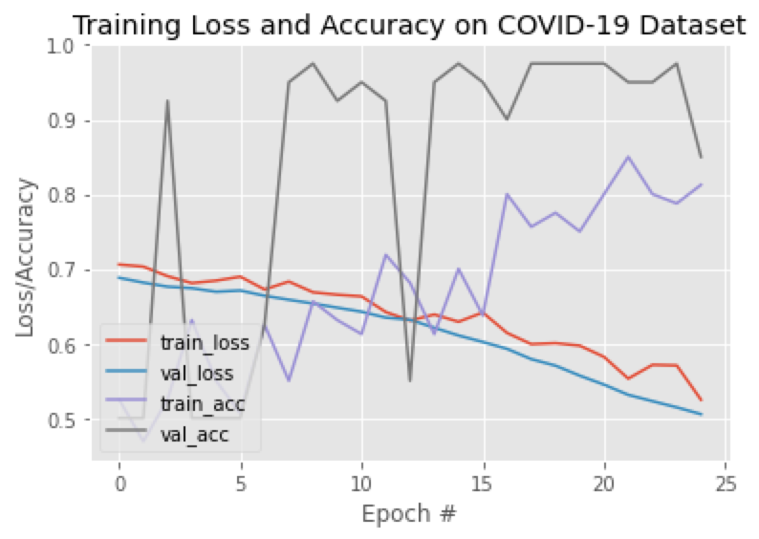
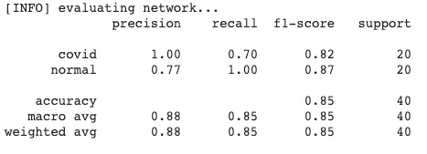
Results(ResNet 101)
BS = 8
EPOCHS = 25
LR = 0.001

Slide 9
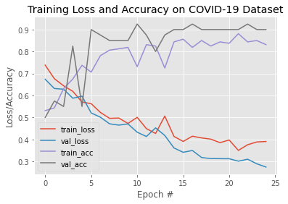
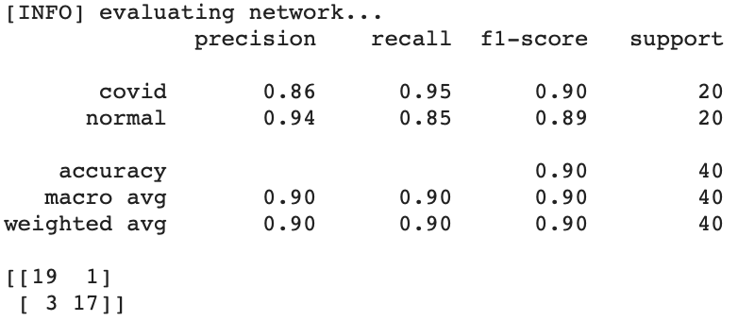
Results(ResNet 101 + Transfer Learning)
BS = 8
EPOCHS = 25
LR = 0.001

Slide 10
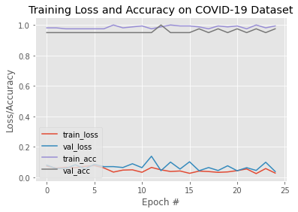
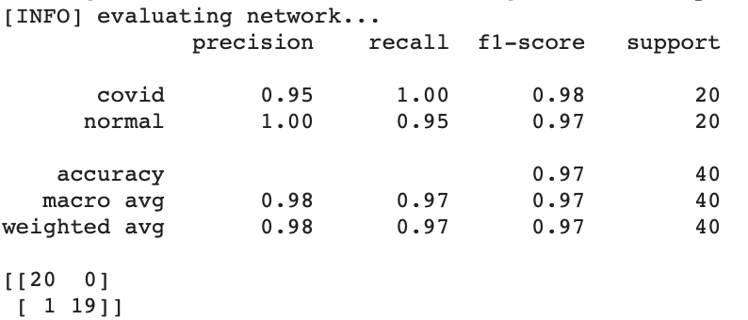
Results(VGG16 + Transfer Learning)
BS = 8
EPOCHS = 25
LR = 0.001
BS = 8
EPOCHS = 25
LR = 0.001

Slide 11
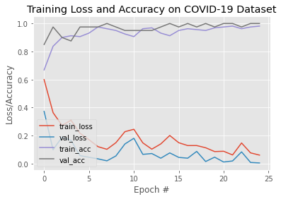
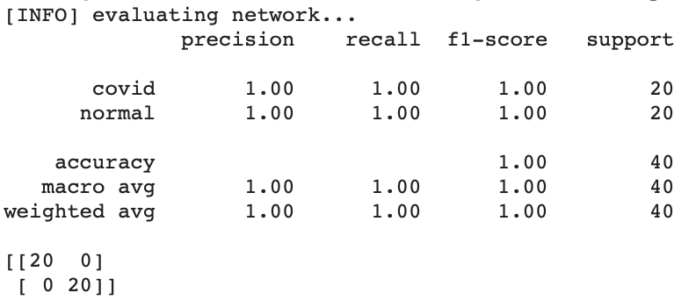
Results(Self-constructed CNN)
BS = 8
EPOCHS = 25
LR = 0.001
BS = 8
EPOCHS = 25
LR = 0.001

Slide 12
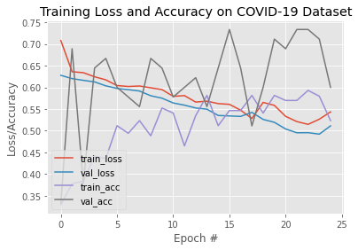
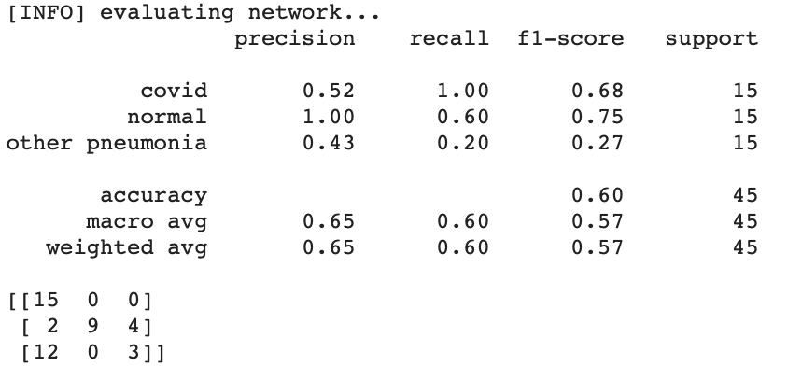
Results(ResNet 101 + Transfer Learning 3 classes)
BS = 8
EPOCHS = 25
LR = 0.001

Slide 13
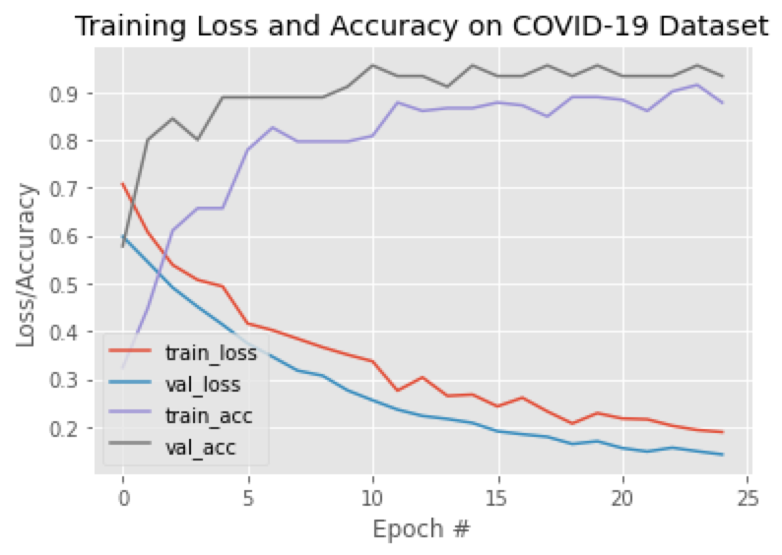
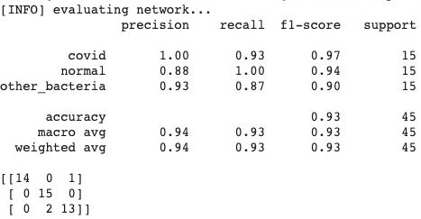
Results(VGG 16 + Transfer Learning 3 classes)
BS = 8
EPOCHS = 25
LR = 0.001

Slide 14
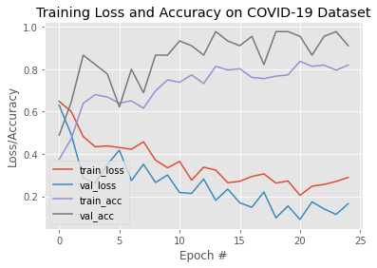
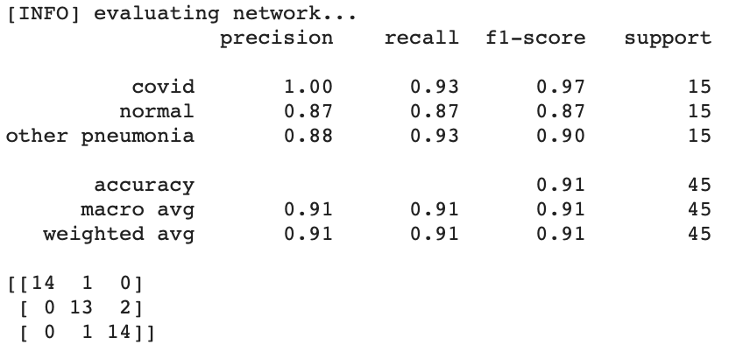
Results(Self-constructed CNN 3 classes)
BS = 8
EPOCHS = 25
LR = 0.001

Slide 15
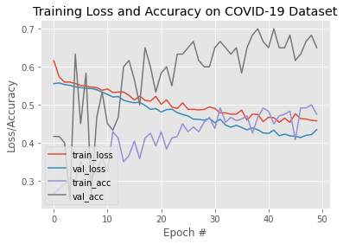
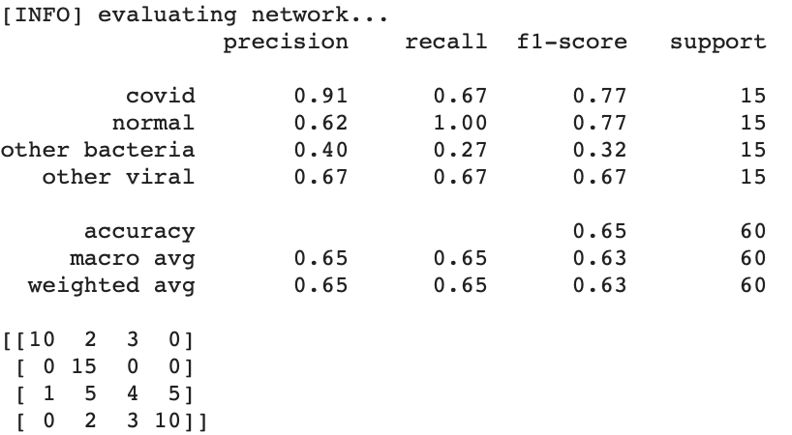
Results(ResNet 101 + Transfer Learning 4 classes)
BS = 8
EPOCHS = 50
LR = 0.001

Slide 16
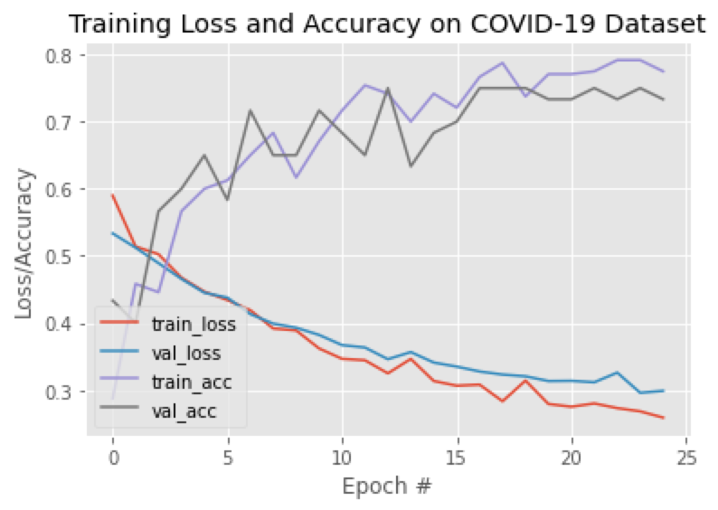
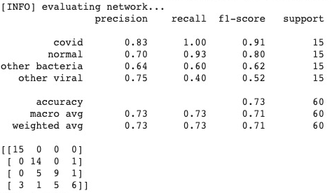
Results(VGG 16 + Transfer Learning 4 classes)
BS = 8
EPOCHS = 50
LR = 0.001

Slide 17
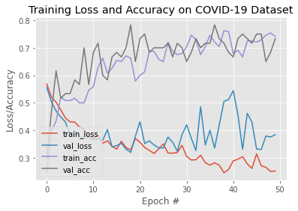
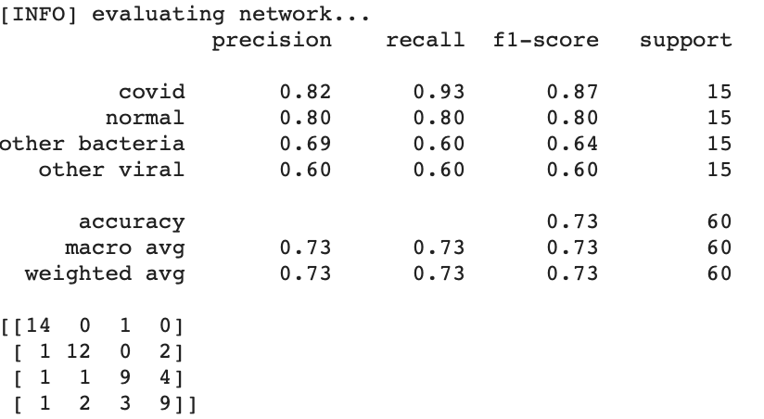
Results(Self-constructed CNN 4 classes)
BS = 8
EPOCHS = 50
LR = 0.001

Slide 18
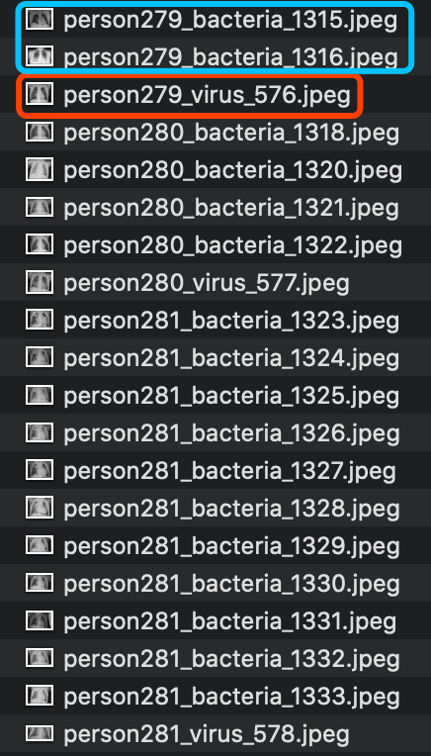
Why 4 classes is bad
Small dataset
More classes, model becomes more complex
Need data augmentation or collect more data
Bacterial pneumonia vs.viral pneumonia
Some patient are labeled as both
For example: person 279 280 281
Bacterial pneumonia and viral pneumonia are often not clearly to separate.

Slide 19
Ablation(Covid vs Healthy) Study
Model | Description | Test Accuracy
ResNet 101 (transfer learning) | 100 normal :100 covid | 90%
VGG 16 (transfer learning) | 100 normal :100 covid | 97.5%
CNN | 100 normal :100 covid | 100%
ResNet 101 (transfer learning) | 75 normal :75 covid : 75 other pneumonia | 65%
VGG 16 (transfer learning) | 75 normal :75 covid : 75 other pneumonia | 93%
CNN | 75 normal :75 covid : 75 other pneumonia | 91%
ResNet 101 (transfer learning) | 75 normal :75 covid : 75 other bacterial : 75 other viral | 65%
VGG 16 (transfer learning) | 75 normal :75 covid : 75 other bacterial : 75 other viral | 73%
CNN | 75 normal :75 covid : 75 other bacterial : 75 other viral | 73%

Slide 20
Limitation and Future Improvement
Small dataset
The available dataset is too small to train a deep neural network
Need to do some data augmentation or collect more data
High recall rate for Covid-19
Some cases which are not Covid-19 are classified to be Covid-19. Not efficient!
Collect more data so that the model can obtain more features

Slide 21
References
[1]Simonyan, Karen, and Andrew Zisserman. "Very deep convolutional networks for large-scale image recognition." arXiv preprint arXiv:1409.1556 (2014).
[2]Huang, G., Liu, Z., Van Der Maaten, L. and Weinberger, K.Q., 2017. Densely connected convolutional networks. In Proceedings of the IEEE conference on computer vision and pattern recognition (pp. 4700-4708).
[3]Narin, A., Kaya, C. and Pamuk, Z., 2020. Automatic Detection of Coronavirus Disease (COVID-19) Using X-ray Images and Deep Convolutional Neural Networks. arXiv preprint arXiv:2003.10849.

